Slide 1



Inputs
Process
Output
Ingredient A (60%)
Ingredient B (25%)
C (15%)

Slide 2
Inputs
Process
Output
Ingredient A (60%)
Ingredient B (25%)
C (15%)

Slide 3
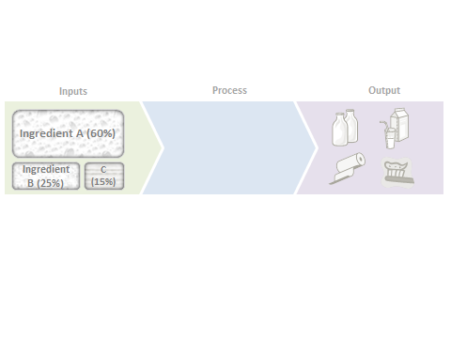
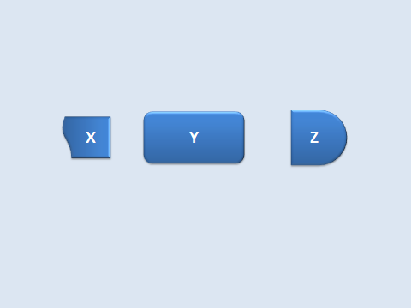
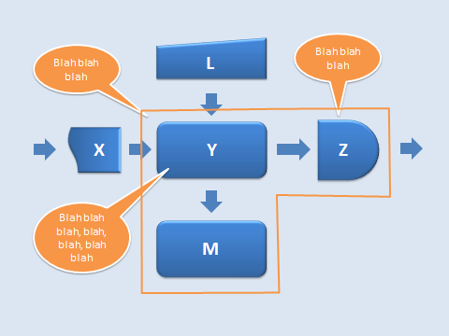
‘big picture’ slide
‘drill down’ slide
Slide with even more details

Slide 4
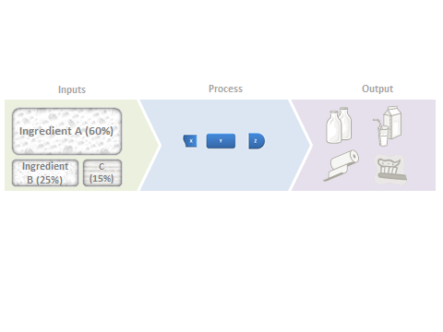
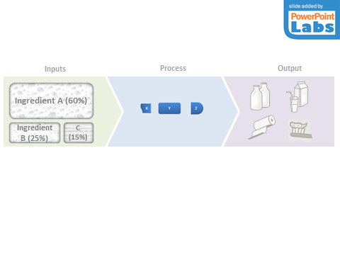
Rectangle replaced with picture
Animation slide added

Slide 5

Inputs
Process
Output
Ingredient A (60%)
Ingredient B (25%)
C (15%)

Slide 6


Slide 7
X
Y
Z

Slide 8
L
Blah blah blah
Blah blah blah
X
Y
Z
Blah blah blah, blah, blah, blah blah
M

Slide 9
L
X
Y
Z
M

Slide 10
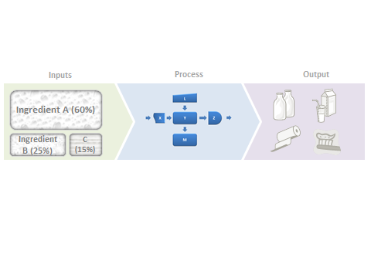

Slide 11
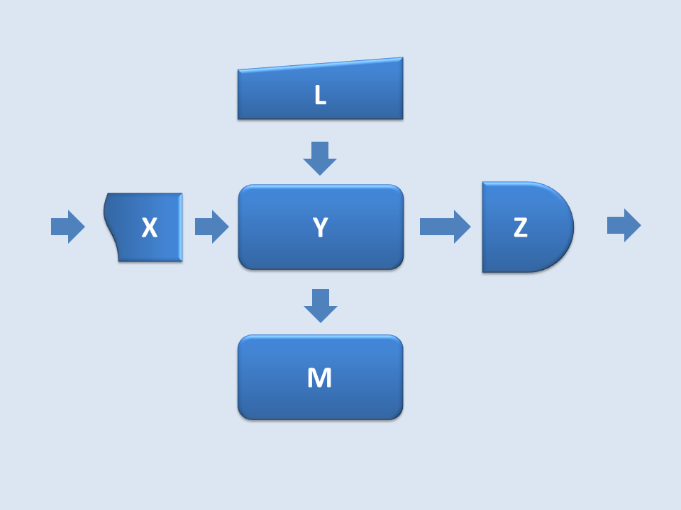
Inputs
Process
Output
Ingredient A (60%)
Ingredient B (25%)
C (15%)

Slide 12
